Slide 1


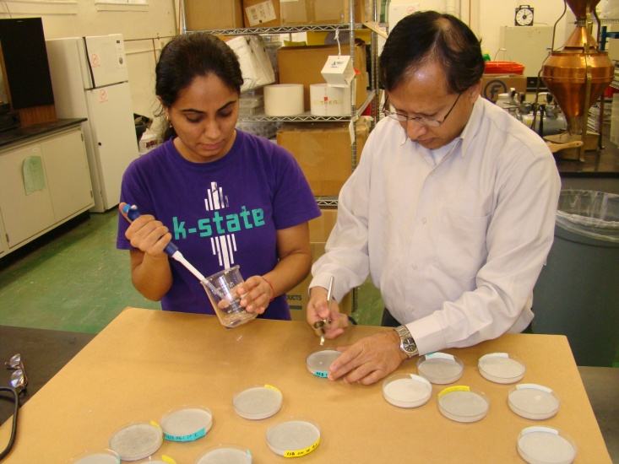
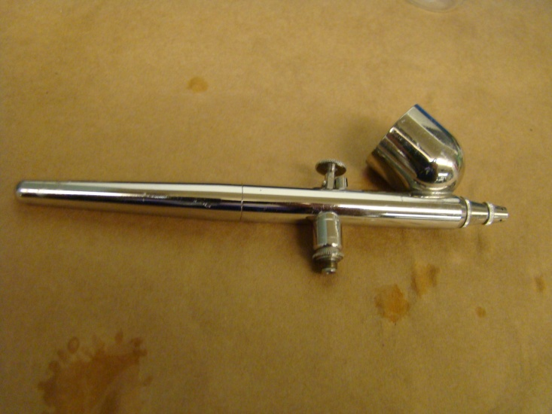
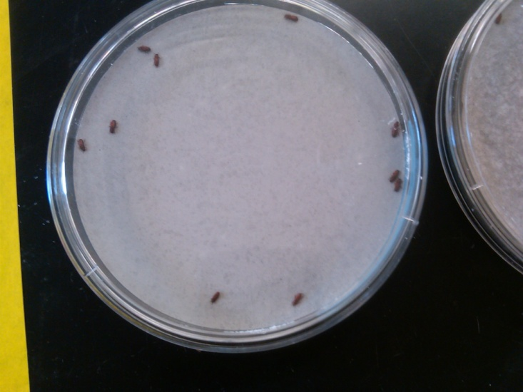
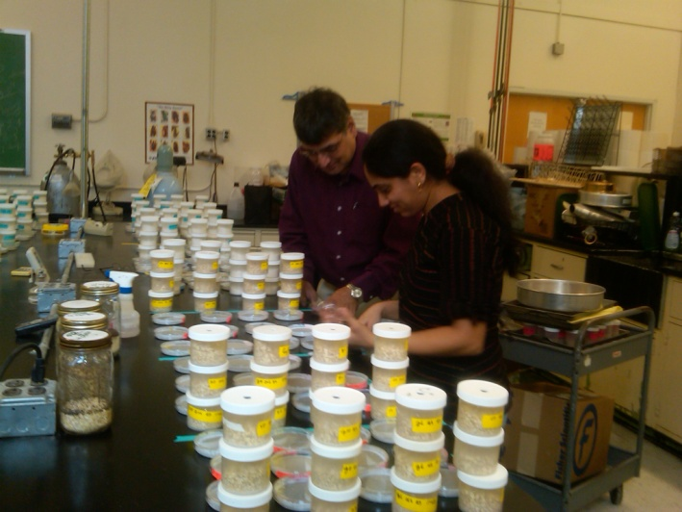
Variation in susceptibility of insects associated with Kansas farm-stored grain to insecticides recommended for empty bin treatments
Blossom Sehgal
Department of Grain Science and Industry, Kansas State University, Manhattan, KS 66506
Introduction
Applying a recommended insecticide to clean, concrete surfaces of empty round metal farm bins is essential to kill residual insect infestations prior to storing newly-harvested grain. Cyfluthrin and chlorpyrifos-methyl + deltamethrin are insecticides recommended for disinfesting empty bins. The wettable powder (WP) and emulsifiable concentrate (EC) formulations of cyfluthrin have been replaced in 2011 by a new β-cyfluthrin soluble concentrate (SC) formulation (11.8% active ingredient [AI]). The trade name of this product is Tempo® SC Ultra. The chlorpyrifos-methyl + deltamethrin, with the trade name StorcideTM II, was registered in 2007 for treatment of empty bins receiving wheat, sorghum, rice, barley, and oats. On bin concrete surfaces, cyfluthrin is recommended at 0.01 g (AI)/m² (low rate) or 0.02 g (AI)/m² (high rate). Chlorpyrifos-methyl + deltamethrin is recommended at 0.12 + 0.02 g (AI)/m². The effectiveness of these currently registered products has not been evaluated against laboratory and field populations of insect species associated with farm-stored grain. Such assessments are important to make recommendations to producers, and also to determine if field populations of stored-grain insects can be effectively controlled at the labeled rates. In this investigation, the effectiveness of cyfluthrin and chlorpyrifos-methyl + deltamethrin applied to concrete surfaces was characterized against adults of laboratory-reared and field collected populations of the red flour beetle, Tribolium castaneum (Herbst) (Coleoptera: Tenebrionidae); lesser grain borer, Rhyzopertha dominica (F.) (Coleoptera: Bostrichidae); and sawtoothed grain beetle, Oryzaephilus surinamensis (L.) (Coleoptera: Silvanidae).
Hypotheses
Adults of the three stored-grain insects collected from different sites in Kansas and a few from outside Kansas vary in their susceptibility to cyfluthrin and chlorpyrifos-methyl + deltamethrin.
The field strains will be less susceptible to the two insecticides at the labeled rates than the corresponding laboratory strains.
Fig 1. Knockdown and mortality responses of laboratory strains of the three insect species exposed to the two insecticides on concrete.
Materials and Methods
Collection of field strains: Several farm sites and a few food-processing facilities in Kansas were visited between July and November 2011 to collect 14 field strains of T. castaneum, 1 strain of R. dominica, and 8 strains of O. surinamensis. In addition, 1 strain each of T. castaneum from Arizona, Illinois, and Missouri were also included in this study. Insects maintained in the laboratory since 1999 on standard diets served as the insecticide-susceptible strains.
Treatment of concrete dishes with insecticides: A slurry of ready-mix concrete (Rockite, Hartline Products Co., Inc., Cleveland, Ohio) in water was poured into plastic Petri dishes measuring 9-cm diameter x 1.5-cm high with a surface area of 62 cm². All insecticide dilutions were made in distilled water. Each dish was treated with 250 µl of cyfluthrin solution at the low or high labeled rate or with 250 µl of chlorpyrifos-methyl + deltamethrin (C-methyl + deltamethrin) at the labeled rate using a Badger 100 artist’s airbrush (Model 100, Franklin Park, IL).
Insect exposure and responses of laboratory strains: Ten unsexed 1-2-week-old adults of T. castaneum R. dominica, and O. surinamensis reared in the laboratory were exposed on treated dishes for 1, 2, 4, 8, 12, 16, 20 and 24 h. Separate dishes were used for different time periods. Each species, insecticide, rate, and time combination was replicated three times. Adults that were knocked down or moribund were counted and transferred to 150-ml round plastic container with 30 g of the insect diet and incubated at 28○C and 65% RH for 7 days for assessing mortality and for 42 days to count adult progeny production. Knockdown or mortality data of insects was expressed as a percentage. Regression models were fit to data and the time for 100% or near 100% mortality was determined as the exposure time to evaluate efficacy against the field strains with the two insecticides.
Exposure of field strains: The high rate was used against the field strains. Adults of field strains of T. castaneum and O. surinamensis were exposed for 24 h on cylfuthrin-treated concrete dishes while R. dominica was exposed for 2 h. All three species were exposed for 8 h to chlorpyrifos-methyl + deltamethrin-treated concrete dishes. Knockdown, mortality, and adult progeny production of field strains were determined and each of these variables among strains and insecticides were compared using two-way analysis of variance (ANOVA) and lsmeans test at α = 0.05. The three least susceptible strains of T. castaneum and two of O. surinamensis were selected for dose-response tests with β-cyfluthrin with 1X to 4X times the high labeled rate to determine knockdown and mortality.
Test conditions: The dose-response tests with laboratory strains were conducted at 24.3°C and 23.5% RH. All other tests were conducted at 28°C and 65% relative humidity.
Table 2. Knockdown, mortality, and adult progeny production of insect strains exposed to cyfluthrin high rate on concrete.
Fig 2. Knockdown and mortality of laboratory and least susceptible fields strains of two insect species exposed to 1X-4X the high labeled rate of cyfluthrin.
Species | Strain | Mean ± SE
 |  | % Knockdown | % Mortality | No. adult progeny
T. castaneum | Lab | 92.0 ± 2.0bcd | 39.3 ± 10.7abc | 5.2 ± 3.8d
 | Abilene 1 | 91.5 ± 2.2bcd | 23.4 ± 6.3bcde | 28.2 ± 16.3cd
 | Abilene 2 | 88.4 ± 2.1cd | 21.1 ± 5.4bcde | 35.2 ± 9.3abc
 | Clifton | 94.0 ± 2.4abc | 16.2 ± 3.9cde | 124.2 ± 29.4ab
 | Canton | 92.4 ± 3.5abcd | 20.7 ± 7.1bcde | 130.2 ± 27ab
 | Gorham | 92.2 ± 2.0bcd | 24.0 ± 8.7bcde | 125.8 ± 41abc
 | Stafford | 88.0 ± 2.0cd | 16.0 ± 7.5de | 187.0 ± 24.4a
 | Minneapolis 1 | 98.0 ± 2.0a | 48.0 ± 8.6ab | 19.2 ± 7.8cd
 | Minneapolis 2 | 98.3 ± 1.7a | 51.4 ± 16.1a | 47.4 ± 20.2cd
 | Paradise 1 | 87.8 ± 2.0cd | 12.9 ± 6.8e | 131.6 ± 32.6ab
 | Paradise 2 | 92.7 ± 3.2abcd | 23.3 ± 8.2bcde | 80.8 ± 22.3abc
 | Kansas | 90.4 ± 0.2cd | 41.7 ± 8.4abc | 73.2 ± 42.0bc
 | Dickinson | 88.5 ± 3.6bcd | 26.0 ± 8.1bcde | 216.2 ± 50.4a
 | Tipton | 86.0 ± 2.4d | 10.2 ± 5.5e | 158.2 ± 35.1ab
 | Jackson, MO | 96.0 ± 2.4ab | 35.3 ± 8.1abcd | 82.2 ± 30.7abc
 | Maricopa, AZ | 92.0 ± 3.7abcd | 18.0 ± 11.1de | 158.6 ± 65.8abc
 | Bridgeview, IL | 92.2 ± 2.0bcd | 41.1 ± 9.1abc | 160.6 ± 35.6ab
R. dominica | Lab | 100.0 ± 0.0ª | 100.0 ± 0.0 | 0.0 ± 0.0ª
 | Clifton | 98.0 ± 2.0 | 100.0 ± 0.0 | 0.8 ± 0.8
 | Riley | 100.0 ± 0.0 | 100.0 ± 0.0 | 0.0 ± 0.0
O. surinamensis | Lab | 100.0 ± 0.0a | 95.1 ± 3.0a | 1.2 ± 1.2cd
 | Abilene 1 | 52.7 ± 6.9b | 5.0 ± 3.6c | 32.8 ± 7.8a
 | Abilene 2 | 58.3 ± 7.5b | 13.7 ± 7.4c | 47.2 ± 7.2a
 | Canton | 98.2 ± 1.8a | 73.7 ± 8.5b | 5.4 ± 4.9bcd
 | Clifton | 100.0 ± 0.0a | 76.7 ± 6.4b | 6.8 ± 4.0bc
 | Minneapolis | 96.0 ± 2.4a | 69.5 ± 6.3b | 12.4 ± 5.6b
 | Paradise 1 | 100.0 ± 0.0a | 66 ± 16.6ab | 0.2 ± 0.2d
 | Paradise 2 | 94.2 ± 4.0a | 73.2 ± 6.5b | 5.4 ± 5.2bcd
 | Tipton | 100.0 ± 0.0a | 81.7 ± 6.6ab | 0.4 ± 0.2cd
Results
Laboratory strain responses:
The time at which knockdown and mortality reached 100% is shown in Fig 1. For R. dominica, this time was 2 h for the high cyfluthrin rate and 8 h for C-methyl + deltamethrin. Corresponding times for T. castaneum and O. surinamensis were 24 and 8 h. Nonlinear or linear models fitted to KD and mortality data (Table 1) showed significant differences among species and insecticides tested (data not shown).
β-cyfluthrin was more effective against R. dominica within 2 h and caused 100% mortality of insects. Adults of O. surinamensis required 24 h to succumb to cyfluthrin. Mortality of T. castaneum adults even after 24 h exposure to β-cyfluthrin was less than 100% mortality. C-methyl + deltamethrin was effective against all the insect species producing 100% mortality in 8 h.
Field strain responses:
There were significant differences among the field strains of all the species in their susceptibility to both the insecticides (Tables 2 & 3).
The knocked down insects recovered when placed on food. The percent recovery ranged from 0 - 61.2% for C-methyl + deltamethrin and 0 - 90.4% for β-cyfluthrin.
C-methyl + deltamethrin was more effective against T. castaneum strains with mortality ranging from 90 - 100% resulting in effective progeny suppression for all strains. Mortality of O. surinamensis strains ranged from 67 - 100% with good progeny suppression.
Both field strains of R. dominica were less susceptible than the laboratory strain to C-methyl + deltamethrin but not to β-cyfluthrin.
β-cyfluthrin failed to provide adequate control of T. castaneum and O. surinamensis field strains as evidenced by poor mortality and high adult progeny production.
Exposing the least susceptible field strains of T. castaneum and O. surinamensis to 1X - 4X the labeled rate of β-cyfluthrin resulted in effective knockdown but insect mortality was less than satisfactory (Fig. 2).
Each mean is based on n = 5; at each n, 10 insects were exposed.
ª F-value = 1.0; df = 2, 12; P-value = 0.397.
For each species, means among strains followed by different letters are significantly different (P < 0.05; by lsmeans test).
Table 3. Knockdown, mortality and adult progeny production of insect strains exposed to chlorpyrifos-methyl + deltamethrin on concrete.
Species | Strain | Mean ± SE
 |  | % Knockdown | % Mortality | No. adult progeny
T. castaneum | Lab | 100.0 ± 0.0a | 100.0 ± 0.0a | 0.0 ± 0.0b
 | Abilene 1 | 96.0 ± 2.4ab | 96.0 ± 2.4b | 0.0 ± 0.0b
 | Abilene 2 | 98.0 ± 2.0ab | 100.0 ± 0.0a | 0.0 ± 0.0b
 | Clifton | 100.0 ± 0.0a | 100.0 ± 0.0a | 0.0 ± 0.0b
 | Canton | 96.0 ± 4.0ab | 96.0 ± 4.0b | 0.0 ± 0.0b
 | Gorham | 100.0 ± 0.0a | 100.0 ± 0.0a | 0.0 ± 0.0b
 | Stafford | 98.0 ± 2.0ab | 98.0 ± 2.0ab | 3.0 ± 3.0a
 | Minneapolis 1 | 100.0 ± 0.0a | 100.0 ± 0.0a | 0.0 ± 0.0b
 | Minneapolis 2 | 100.0 ± 0.0a | 100.0 ± 0.0a | 0.0 ± 0.0b
 | Paradise 1 | 100.0 ± 0.0a | 100.0 ± 0.0a | 0.0 ± 0.0b
 | Paradise 2 | 100.0 ± 0.0a | 100.0 ± 0.0a | 0.0 ± 0.0b
 | Kansas | 100.0 ± 0.0a | 100.0 ± 0.0a | 0.0 ± 0.0b
 | Dickinson | 100.0 ± 0.0a | 100.0 ± 0.0a | 0.0 ± 0.0b
 | Tipton | 94.0 ± 2.4b | 90.0 ± 3.2c | 0.0 ± 0.0b
 | Jackson, MO | 96.0 ± 2.4ab | 100.0 ± 0.0a | 0.0 ± 0.0b
 | Maricopa, AZ | 100.0 ± 0.0a | 100.0 ± 0.0a | 0.0 ± 0.0b
 | Bridgeview, IL | 100.0 ± 0.0a | 100.0 ± 0.0a | 0.0 ± 0.0b
R. dominica | Lab | 100.0 ± 0.0ª | 94.9 ± 3.1a | 0.0 ± 0.0b
 | Clifton | 98.6 ± 1.4 | 38.2 ± 14.5b | 17.2 ± 3.6a
 | Riley | 98.0 ± 2.0 | 40.2 ± 3.9b | 17.6 ± 4.4a
O. surinamensis | Lab | 100.0 ± 0.0a | 100.0 ± 0.0a | 0.0 ± 0.0b
 | Abilene1 | 87.7 ± 2.0b | 92.4 ± 3.2abc | 0.2 ± 0.2b
 | Abilene 2 | 91.6 ± 4.1ab | 92.7 ± 3.0abc | 0.2 ± 0.2b
 | Canton | 90.0 ± 4.5ab | 93.0 ± 7.0ab | 0.0 ± 0.0b
 | Clifton | 82.0 ± 2.0b | 66.6 ± 5.8d | 4.0 ± 2.3a
 | Minneapolis | 90.0 ± 4.5ab | 97.7 ± 2.3ab | 0.0 ± 0.0b
 | Paradise 1 | 80.0 ± 4.5b | 88.8 ± 3.7abcd | 0.0 ± 0.0b
 | Paradise 2 | 77.1 ± 8.4b | 73.3 ± 11.7cd | 0.2 ± 0.2b
 | Tipton | 81.8 ± 9.7b | 81.1 ± 13.1bcd | 0.0 ± 0.0b
Conclusions
The field strains showed reduced susceptibility to the insecticides tested, especially β-cyfluthrin against T. castaneum and O. surinamensis.
Chlorpyrifos-methyl + delatamethrin can be recommended for empty bin treatments to control T. castaneum and O. surinamensis but not R. dominica.
Reduced susceptibility to the insecticides tested may be due to resistance development in the insect species.
Dose/response tests on laboratory and select field strains will be conducted to verify resistance development.
These results will be shared with producers prior to the 2012 wheat harvest.
Table 1: Parameter estimates (mean ± SE) from regression equations fit to knockdown (KD) and mortality (M) data for laboratory strains shown in Fig. 1.
Species | Insecticide | Response | nª | Mean ± SE for parameters |  | r²
 |  |  |  | a | b
T. castaneum | Cyfluthrin low rate | KD | 8 | 99.49 ±1.10 | -78.85 ± 3.02 | 0.99
 |  | M^{b} | 6 | 22.29 ± 7.81 | 3.18 ± 0.76 | 0.81
 | Cyfluthrin high rate | KD | 8 | 99.56 ± 1.69 | -54.73 ± 4.63 | 0.96
 |  | M^{b} | 8 | 21.59 ± 5.07 | 2.37 ± 0.38 | 0.87
 | C-methyl + deltamethrin | KD | 8 | 102.84 ± 2.24 | -86.38 ± 6.14 | 0.97
 |  | M | 8 | 99.62 ± 0.88 | -84.14 ± 2.40 | 0.99
R. dominica | Cyfluthrin low rate | KD | 8 | 100.41 ± 0.37 | -9.89 ± 1.01 | 0.94
 | Cyfluthrin high rate | KD | 8 | 100.40 ± 0.36 | -9.60 ± 0.98 | 0.94
 | C-methyl + deltamethrin | KD | 8 | 103.06 ± 2.60 | -82.75 ± 7.12 | 0.96
 |  | M | 8 | 89.43 ± 5.81 | -87.58 ± 15.92 | 0.83
O. surinamensis | Cyfluthrin low rate | M | 6 | 91.02 ± 2.42 | -23.91 ± 5.93 | 0.80
 | Cyfluthrin high rate | M | 5 | 101.51 ± 1.68 | -1655.78 ± 211.64 | 0.95
 |  | KD | 8 | 100.00 ± 0.23 | -39.60 ± 0.63 | 0.99
 | C-methyl + deltamethrin | M | 8 | 98.19 ± 3.70 | -56.84 ± 10.13 | 0.84
Acknowledgements
Research reported here was funded by Bayer Crop Science (Research Triangle Park, NC) and by the Kansas State University Agricultural Experiment Station.
Supervisory committee
Bhadriraju Subramanyam, Department of Grain Science & Industry; Bikram Gill, Department of Plant Pathology; and Frank H. Arthur, USDA-CGAHR, Manhattan, KS.
Models were not fit to data where knockdown or mortality was 100%.
ªn = number of observations.
^{b}Linear equation y = a + bx was fit to the data; all other responses were fit to the non-linear equation y = a + b/x².
ª F-value = 0.51; df = 2, 12; P-value = 0.614.

